Slide 1
Premier League
By:
Apoorv Akhouri

Slide 2

Problem Statement
In this project, we will extract season data from 2015 to 2020 & analyze player minutes played of the winning clubs by the season.
We would also see which players of a team repeatedly won the PL in these 6 years.

Slide 3
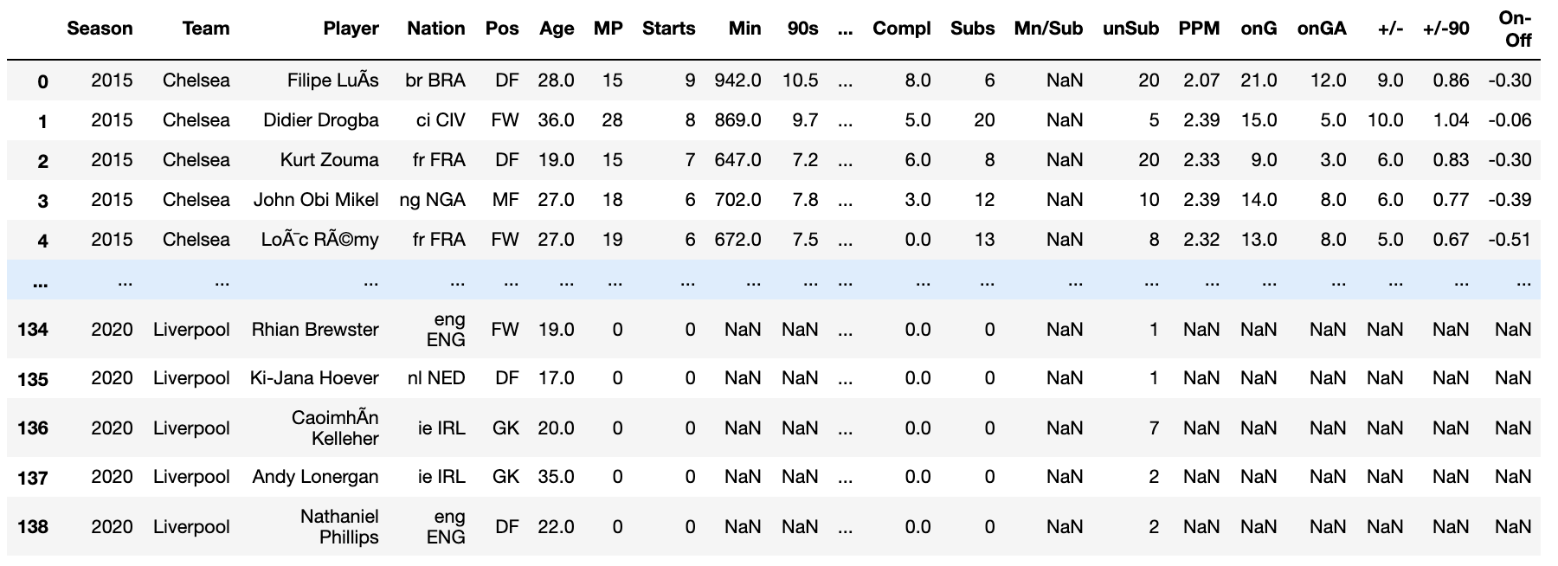
Dataset (Sample)
Data has been extracted from the following link:
https://fbref.com/en/comps/9/400/2009-2010-Premier-League-Stats
Below is a link of the datasets sorted by the season year, that we would be using for the scope of this project:
https://drive.google.com/drive/folders/1tkoRBISsCfdppR8nMsd3csZ5riAk8MAR?usp=sharing

Slide 4
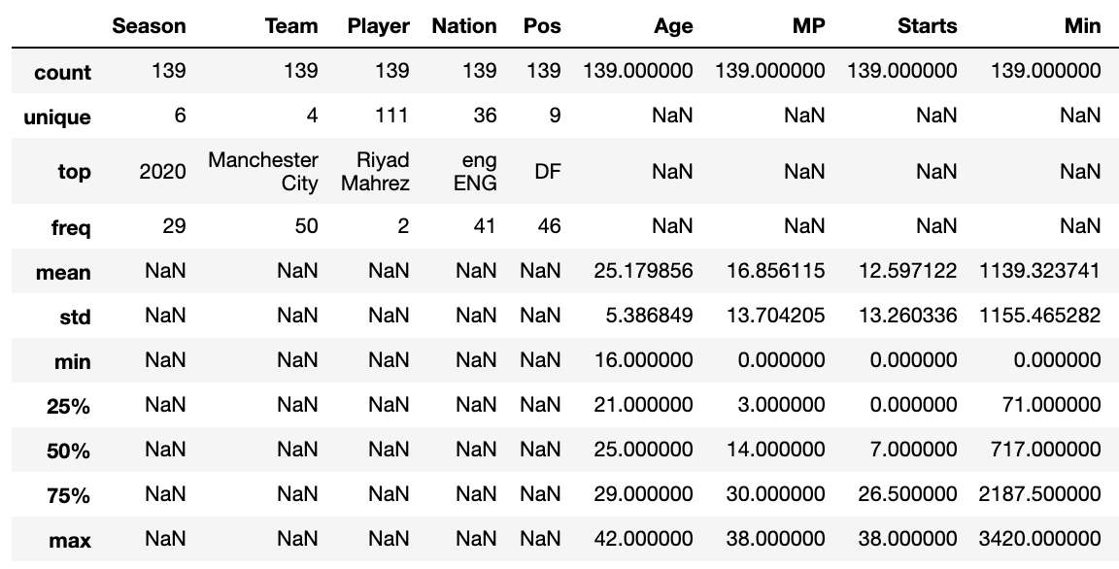
Dataset (Observations)
Here you can see the descriptive stats of our data.
There are a total of 6 seasons we would be analyzing.
4 teams won in these 6 seasons.
139 players would be looked at in this project
Min is our target variable which will be analyzed in the form of weights.

Slide 5



Methods used
For this project, we first understand the data we would be analyzing using Python.
01
We would then create the Nodes & Edges excel files, for our data.
02
These 2 excel files would then be imported to Gephi, cleaned/manipulated, & represented in the form of a network & insights would be gathered.
03

Slide 6
Python & Excel
Sample Data:
df15
df16
df17
df18
df19
df20
We would extract the datasets from our source & combine them as one dataset called ‘data’
We export the dataset ‘data’ as a .csv file to start working on Excel.
On Excel we use filtering to check unique nodes & stored them to the nodes excel file.
Later the edges file was made in the order:
Season : Team : Player
Weights = minutes played in that particular season.
data

Slide 7
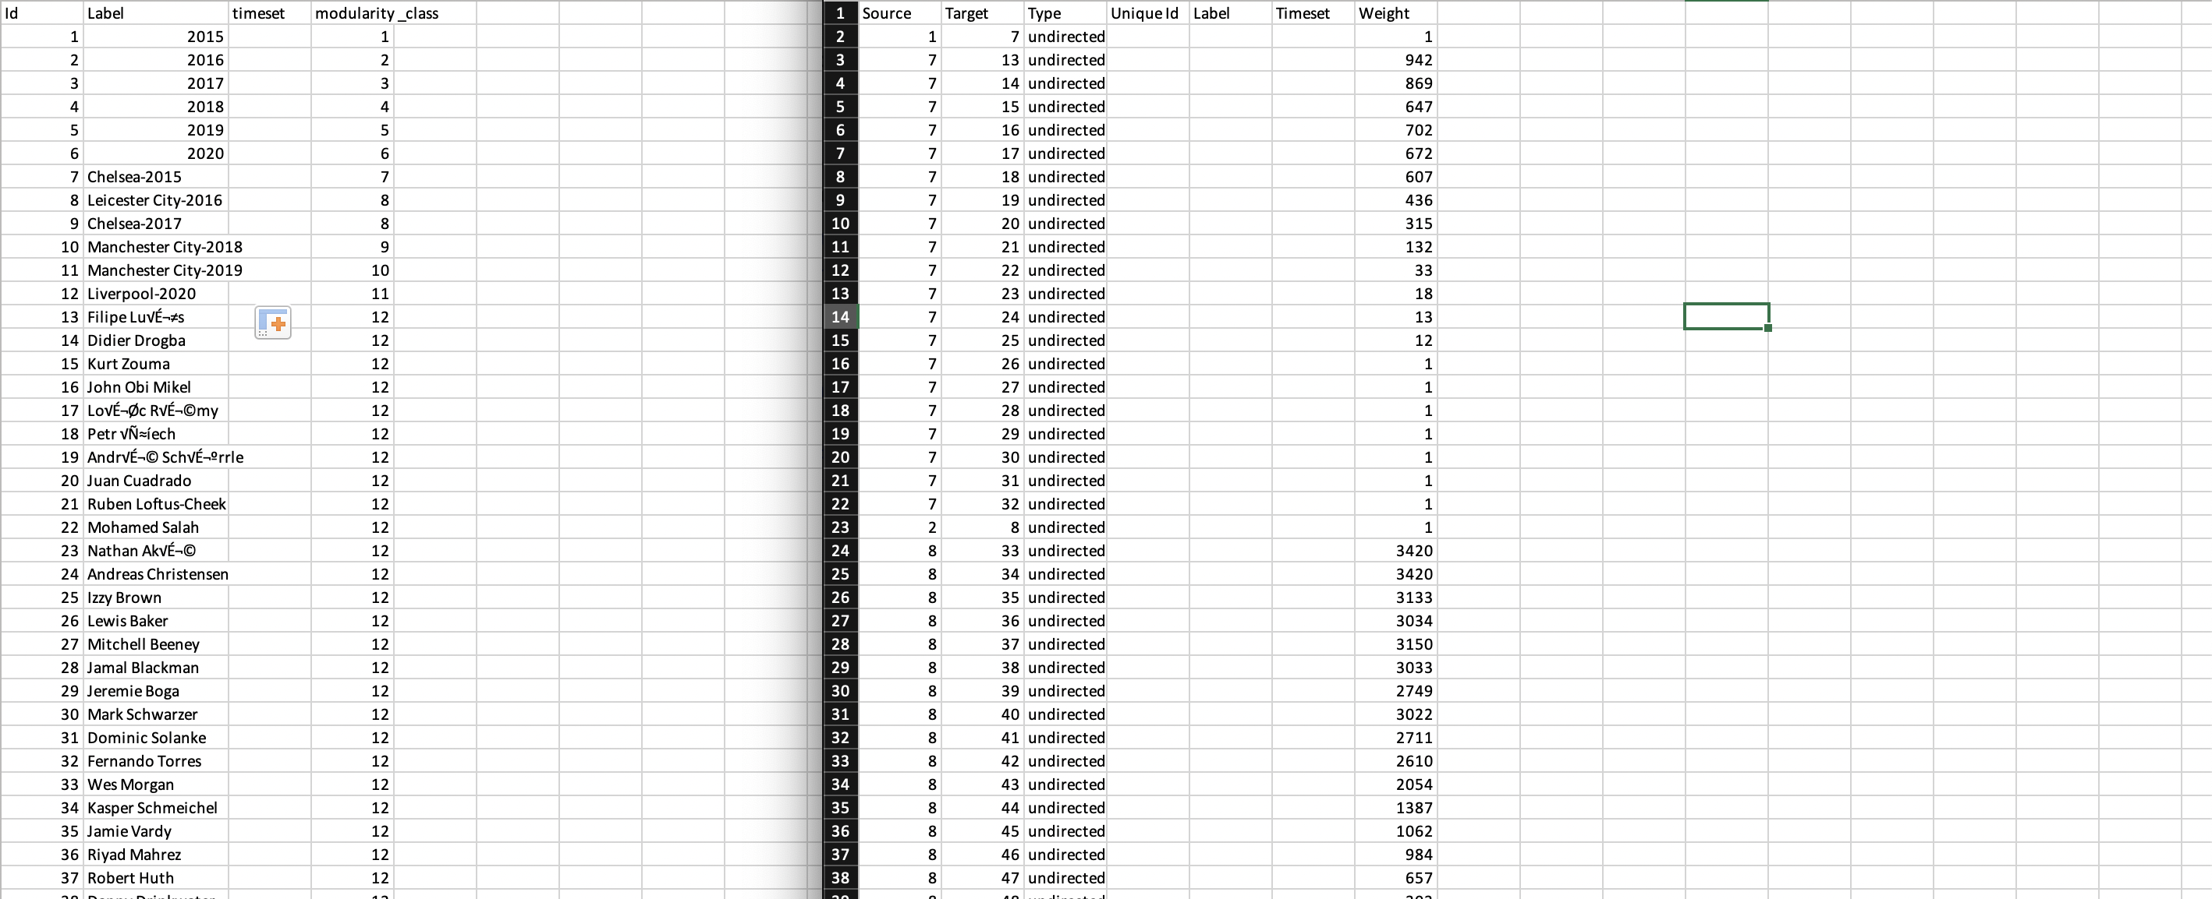
Python & Excel

Slide 8
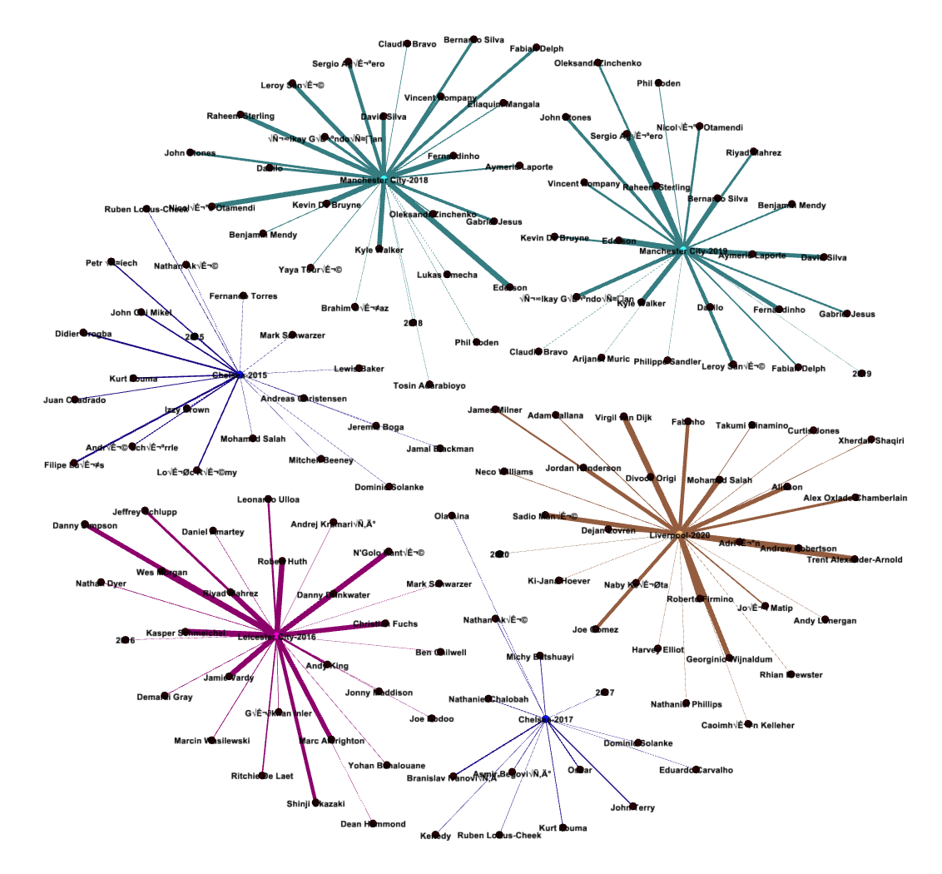
Gephi
The nodes & edges files were imported to Gephi & executed as explained earlier.
Insights were drawn.

Slide 9
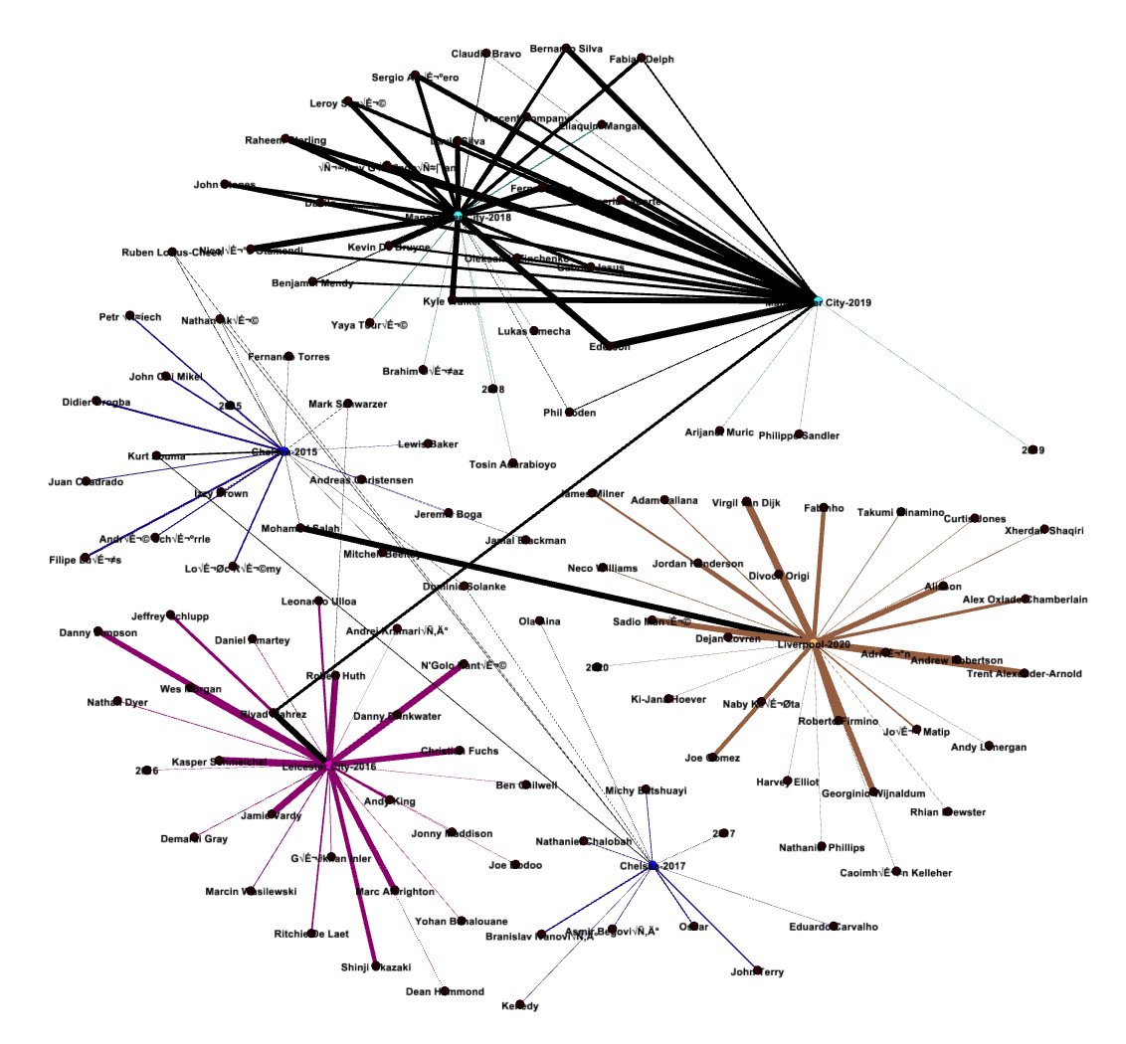
Gephi
Another possibility would be that few players would be repeated in this diagram.
We use Gephi Data Laboratory to check & merge duplicate nodes.

Slide 10
Conclusion & Recommendations
By doing this project, we have created a template for further seasons to store their data, update the nodes & edges list, & gain insights.
Further I would recommend to investigate how Chelsea is winning seasons by playing such less minutes as compared to other teams.

